Slide 1


Submitted to
Sahidulla Ayon (sir)
Present by
Tofayel Ahamd Topu
Id: CSE2202026024
Section: 27M1
Course Title: State of Art Programming Java
Sonargaon University

Slide 2







INHERITANCE
INTERFACE

Slide 3



What is Inheritance
Inheritance is an important OOP Concept in Java, through which a class inherits the properties and behaviors (methods) of another class.

Slide 4
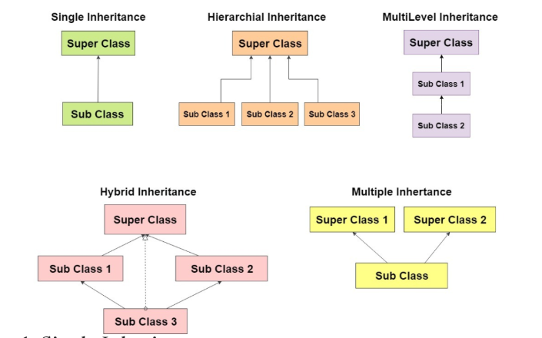
Type of Inheritance
→ Single Inheritance
→ Multiple Inheritance
→ Hierarhcial Inheritance
→ Multilevel Inheritance
→ Hybrid Inheritance

Slide 5
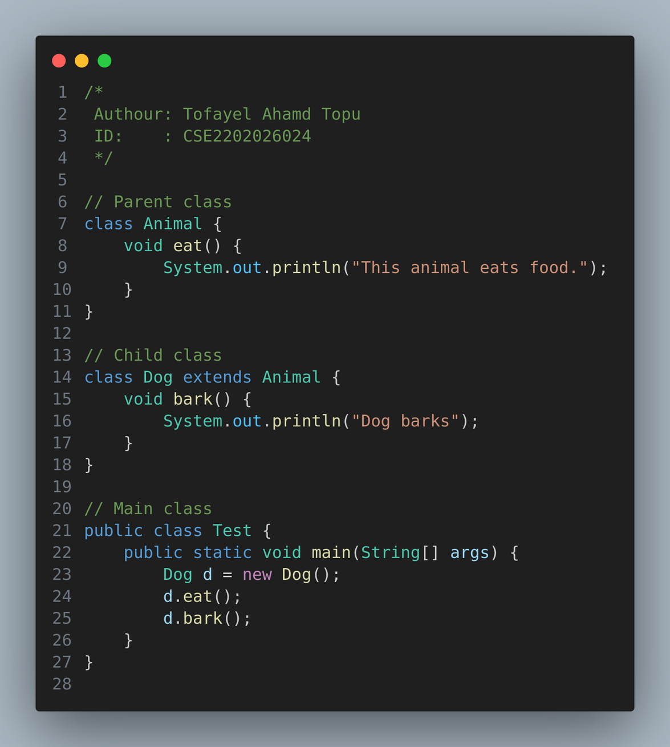
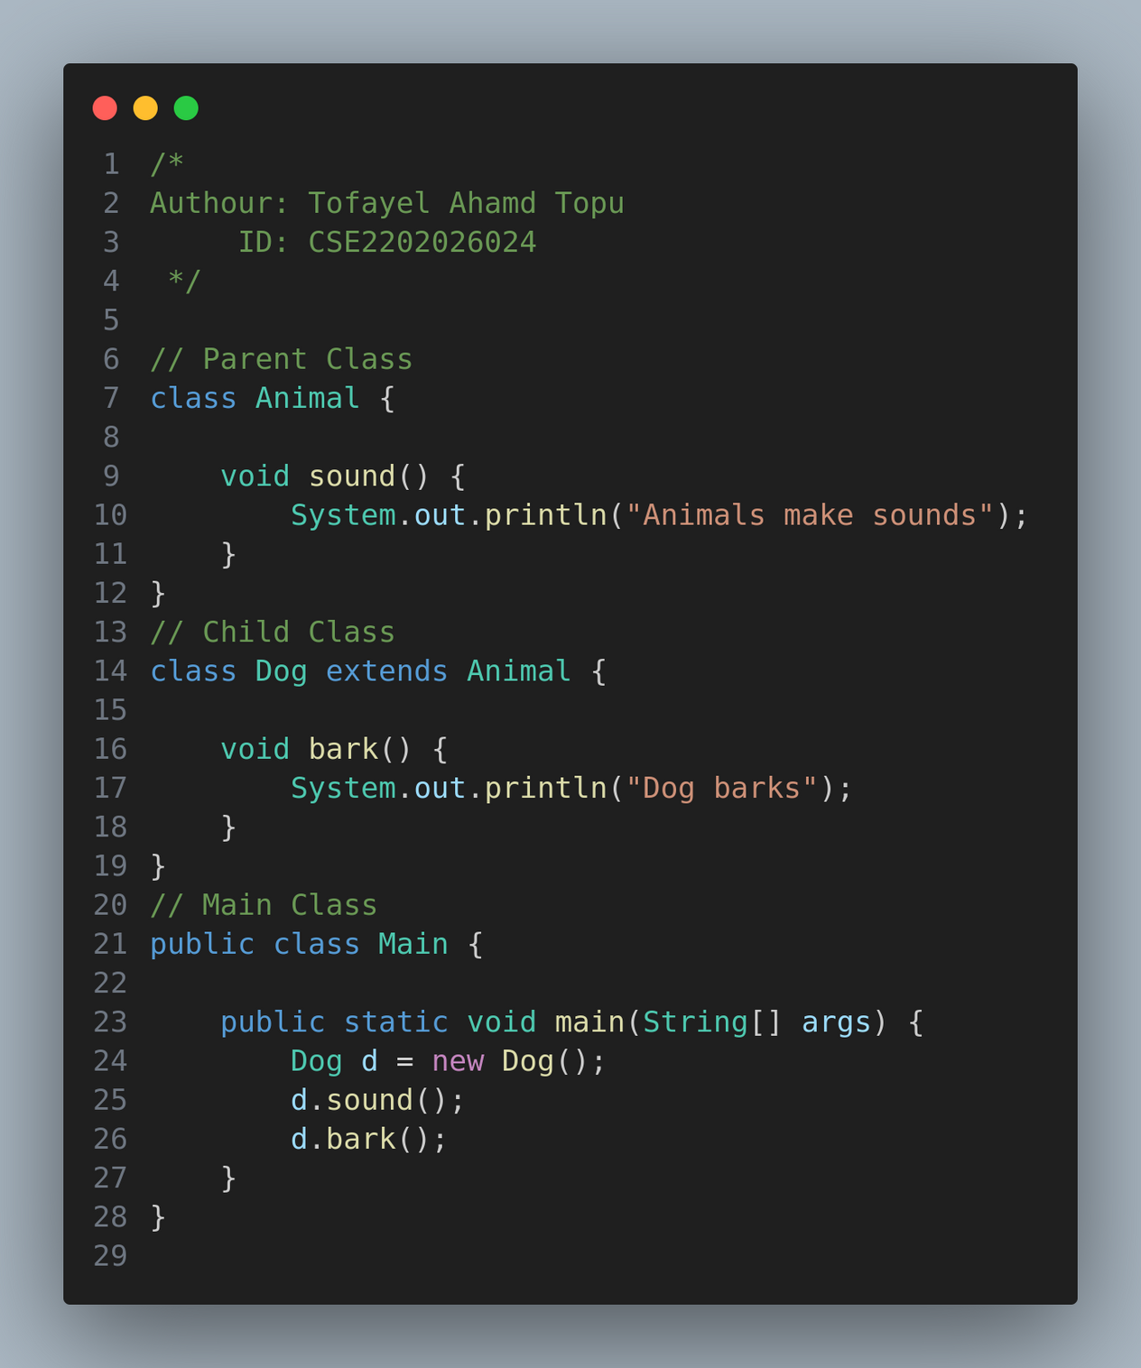


-> Single Ineritance
Benefits
Code Reusability – Code from previous classes can be reused
Maintenance Ease – No need to write the same code over and over
Extensibility – New features can be added easily
Explanation
The Dog class inherits from Animal.
The Dog class itself has created the bark() method.
But the sound() method is inherited from the Animal class.

Slide 6
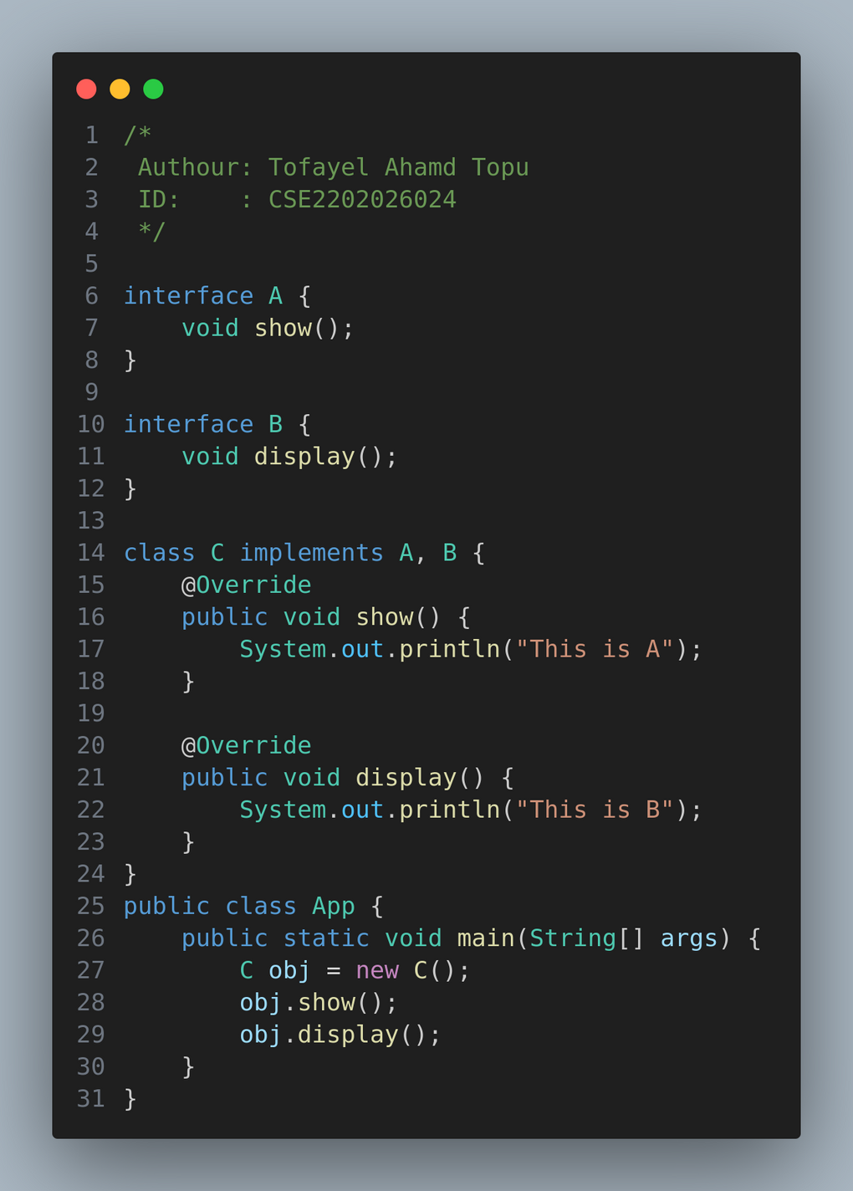
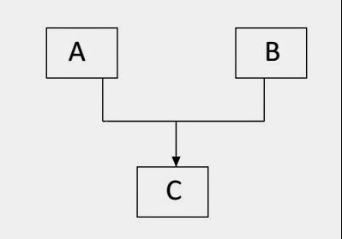
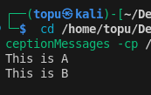
-> Multiple Inheritance
Output

Slide 7
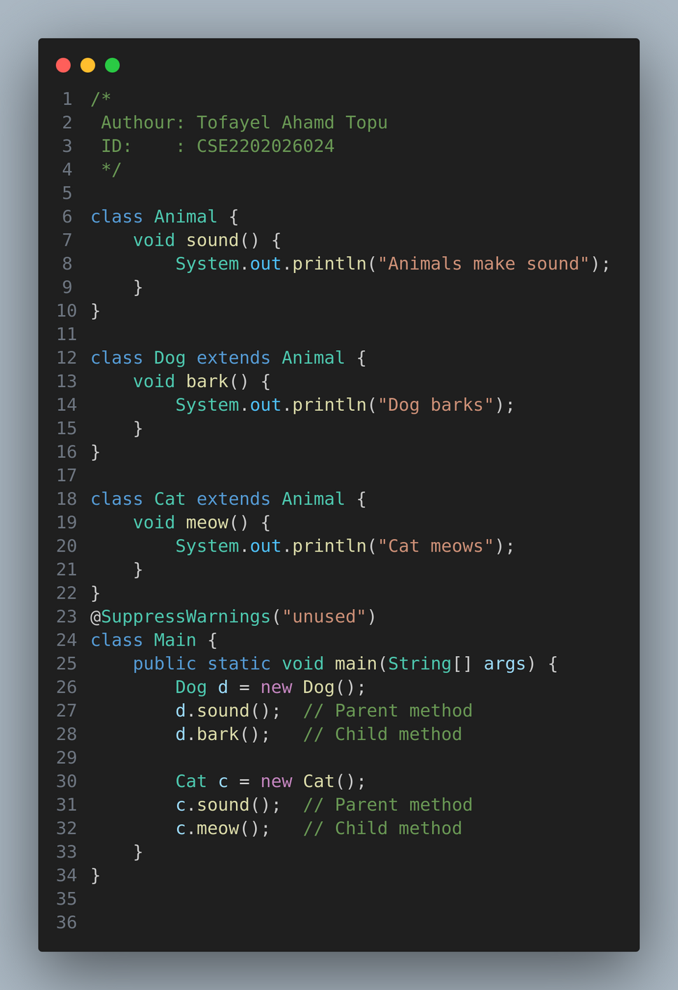
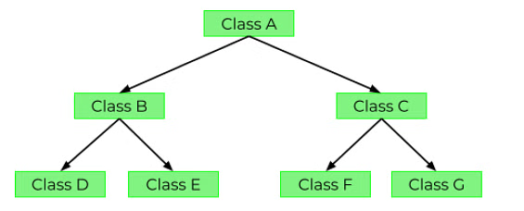
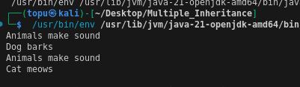
→ Hierarhcial Inheritance
Output

Slide 8
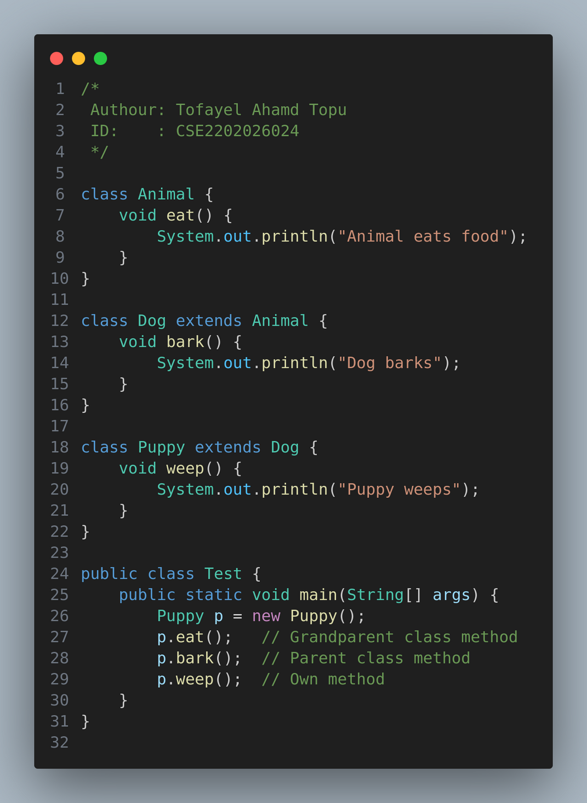
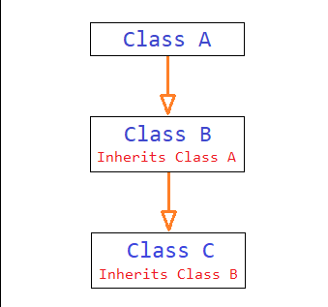
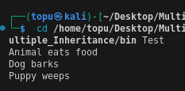
-> Multilevel Inheritance

Slide 9
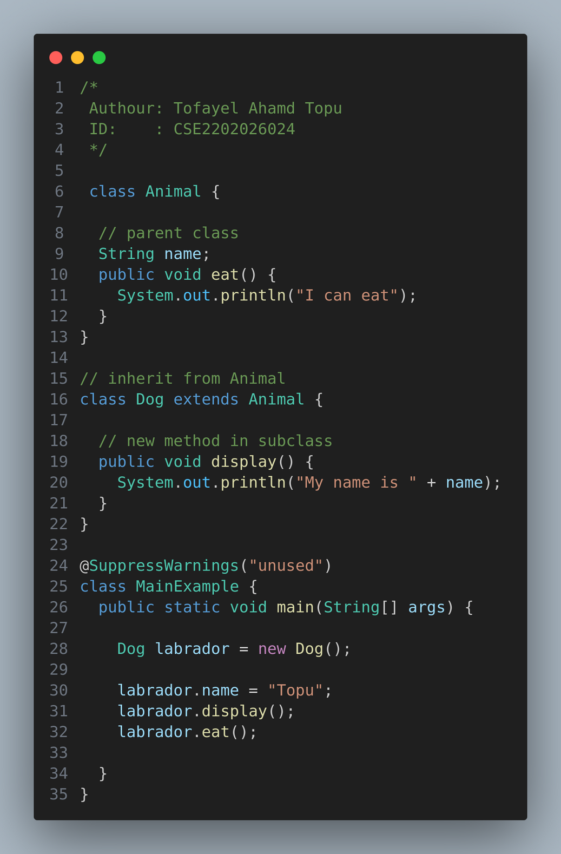
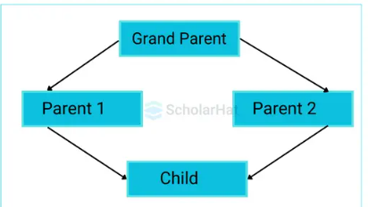
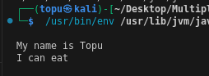
-> Hybrid Inheritance

Slide 10



What is an Interface?
In Java, an Interface is a completely abstract class that contains only the method signature (it means, method name, return type, parameters) and no body or code.

Slide 11
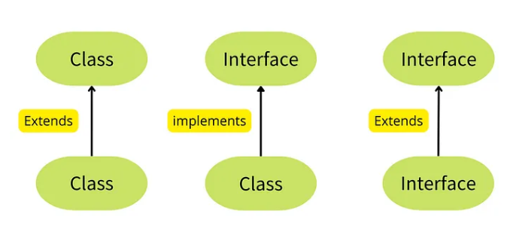

Slide 12
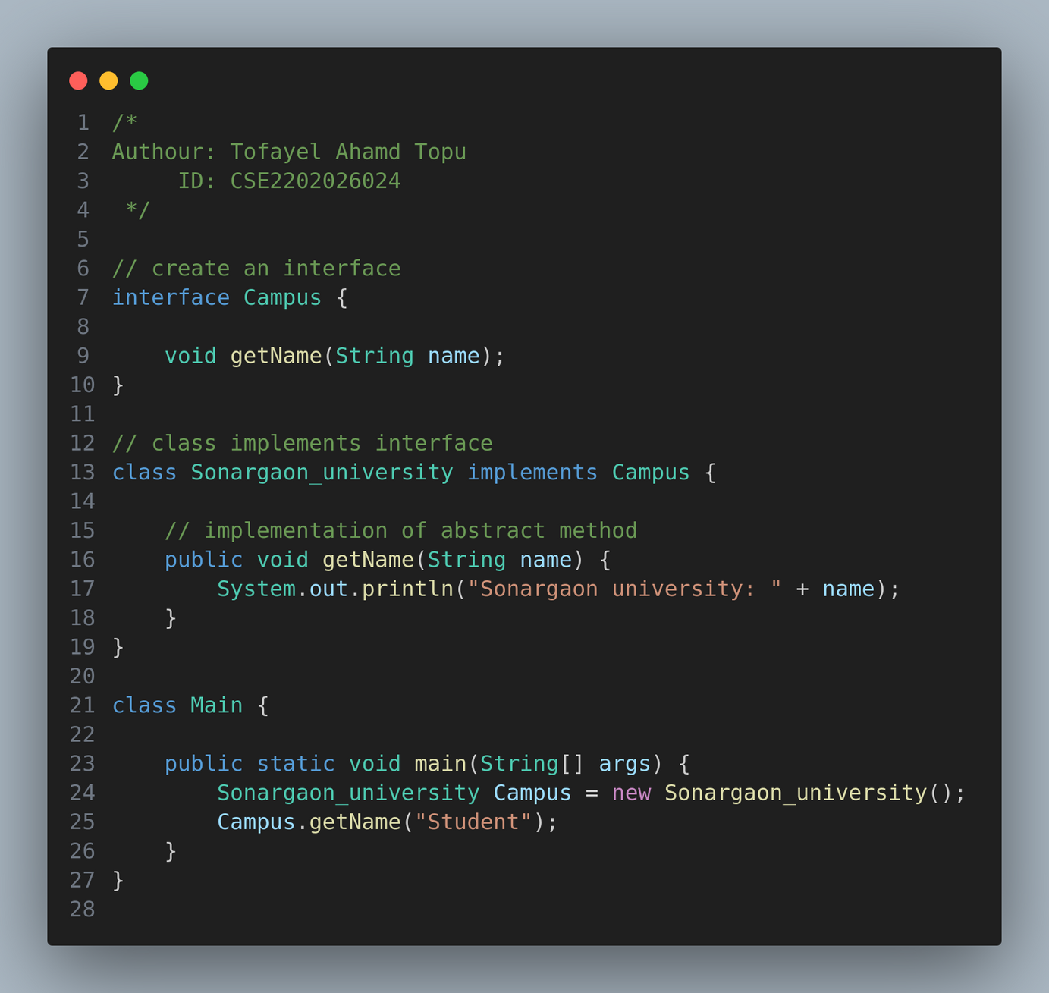
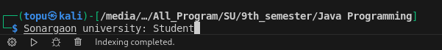
Output

Slide 13


Features of the Interface
Why are interfaces used?
To achieve polymorphism
To take advantage of multiple inheritance
To increase loose coupling and scalability
Contains only method declarations
All methods are public and abstract
All variables are public, static, and final
Supports multiple inheritance

Slide 14

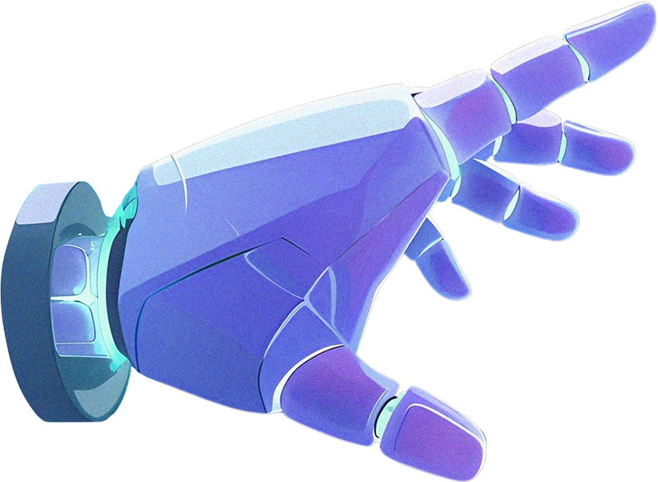



THANK YOU!
topum800@gmail.com
+88 01310260638

